Slide 1
Dominant/Recessive Interactions

Slide 2
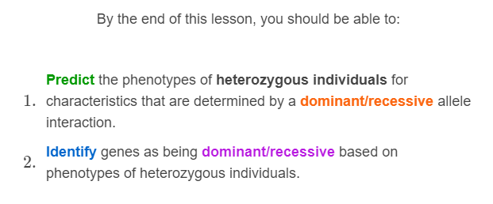


Slide 3

Before examining how incomplete dominance works, we need to review some basic terminology.
You need to know the difference between a gene and an allele, as well as what an individual's genotype and phenotype are.
You also need to know what it means for an individual to be homozygous dominant, heterozygous or homozygous recessive.

Slide 4
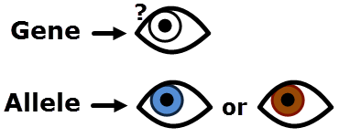
Genes and alleles:
Genes are lengths of DNA that contain information about a characteristic, such as hair or eye colour.
Alleles are variations of a gene. They code for different versions of the same characteristic. These different versions are known as traits.
For example, there is a gene that controls eye colour. One allele for that gene codes for the brown eye trait and another allele codes for the blue eye trait.

Slide 5
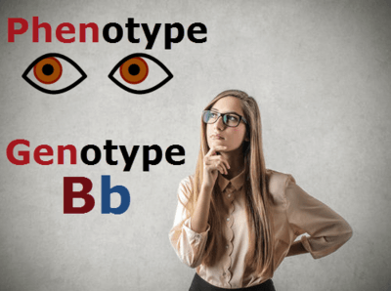
Genotypes and Phenotypes:
An individual's alleles make up their genotype. An individual's traits make up their phenotype.
You can often see a person's phenotype, while their genotype is stored in the DNA in their cells. Remember, a person has two alleles for each gene.
For example, Susan has one allele that codes for brown eyes (B) and one that codes for blue eyes (b). These alleles make a Bb genotype. They interact to produce brown eyes. This is her phenotype.

Slide 6
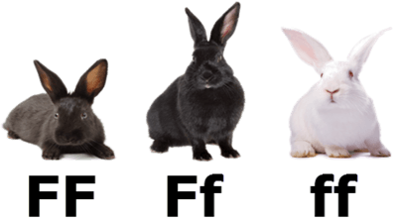
Homozygous and heterozygous:
An individual's genotype can be heterozygous, meaning they have two different alleles. It can also be homozygous, meaning they have two copies of the same allele.
If an individual has two copies of a dominant allele, then they are homozygous dominant. If they have two copies of a recessive allele, then they are homozygous recessive.

Slide 7
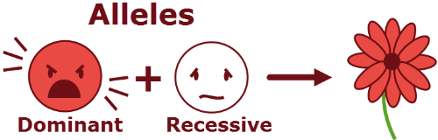
In dominant/recessive interactions, one allele is expressed in favour of another.
When this dominant allele is present, the individual displays the trait that the allele codes for. The other allele doesn't show the trait it codes for. It is hidden!
The allele that is expressed (shown) is known as the dominant trait, while the allele that is hidden is known as the recessive trait.
A person who is heterozygous for this characteristic will look the same as a person who is homozygous dominant for the same characteristic.

Slide 8
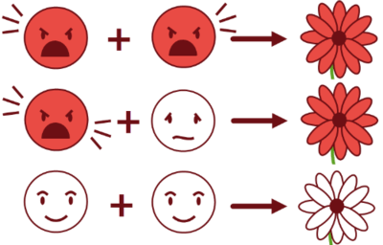
Homozygous dominant individuals, with two copies of the dominant allele, will show the dominant phenotype.
Individuals that are heterozygous, with one dominant and one recessive allele will also show the dominant phenotype.
Only homozygous recessive individuals, with two copies of the recessive allele, will show the recessive phenotype.

Slide 9
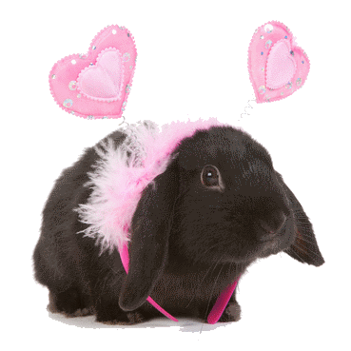
For example, the rabbit below is heterozygous.
It has one allele that codes for black fur and one allele that codes for white fur.
The allele for black fur is dominant, so the rabbit has black fur!

Slide 10
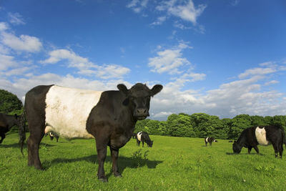
Another example of a dominant/recessive interaction is the white band you sometimes see around the middle of a cow.
Cows with this band are called belted since the band looks like a belt. The belted trait is dominant over the non-belted trait.
Heterozygous and homozygous dominant cows have a belt. Homozygous recessive cows do not.

Slide 11
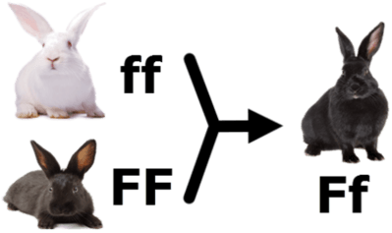
When discussing dominant/recessive allele interactions, we give the dominant allele a capital letter and the recessive allele a lowercase letter.
For example, the allele that codes for the dominant black fur trait in rabbits can be given B, W, F, C or any other capital letter. We then give the allele for the recessive white fur trait a matching lower case letter (r, w, f or c.)

Slide 12
In all dominant/recessive interactions, if an individual has at least one copy of the dominant allele, it will show the dominant phenotype.
So the heterozygous individuals will look just like the homozygous dominant individuals.
Only individuals that are homozygous recessive (have no copies of the dominant allele) will have the recessive phenotype.

